Slide 1
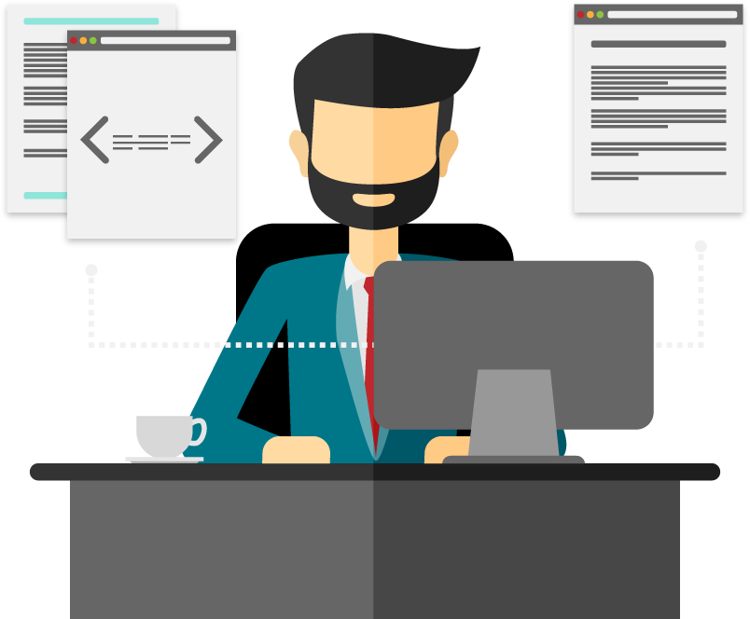

Web Study Jams - Session 3

Slide 2
Recap
Basic JS
Looping concepts
Functions
DOM
Event listeners

Slide 3
What is callback?
Simply put: A callback is a function that is to be executed after another function has finished executing — hence the name ‘call back’.
Callbacks are a way to make sure certain code doesn’t execute until other code has already finished execution.

Slide 4
function first(){ setTimeout(function(){ console.log(1); }, 500 ); }
function second(){ console.log(2); }
first();
second();
function first(){ console.log(1); }
function second(){ console.log(2); }
first(); second();

Slide 5
Why do we need callbacks?
For one very important reason — JavaScript is an event driven language. This means that instead of waiting for a response before moving on, JavaScript will keep executing while listening for other events.

Slide 6
Make a simple callback
function cook(food, callback){
console.log('Cooking '+food);
callback(food);
}
function serve(food){
console.log('Serving '+ food);
}
cook('pizza',serve)

Slide 7
ACTIVITY - 1
REACTION TESTER

Slide 8
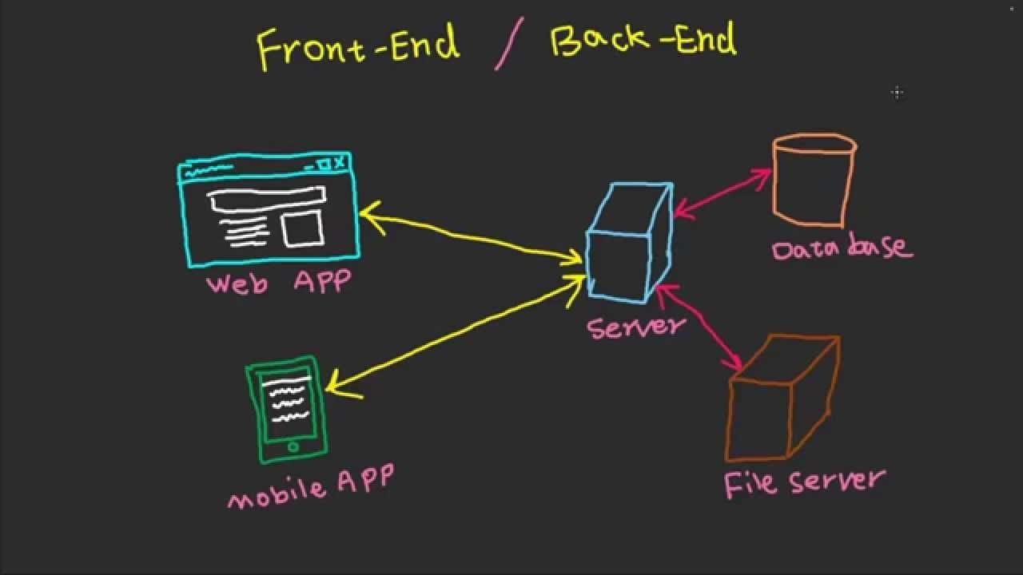
API
An application programming interface (API) is a set of protocols, routines, functions and/or commands that programmers use to develop software or facilitate interaction between distinct systems.

Slide 9
ACTIVITY -2
RANDOM JOKES GENERATOR
http://www.icndb.com/api/

Slide 10
FRAMEWORKS
BOOTSTRAP
MATERIALIZE CSS

